Slide 1

Swinging Atwood Machine
Michael Kister & Alli Behr

Slide 2
Swinging Atwood Machine
m
M

Slide 3
Hamiltonian Approach

Slide 4
Hamiltonian Approach

Slide 5
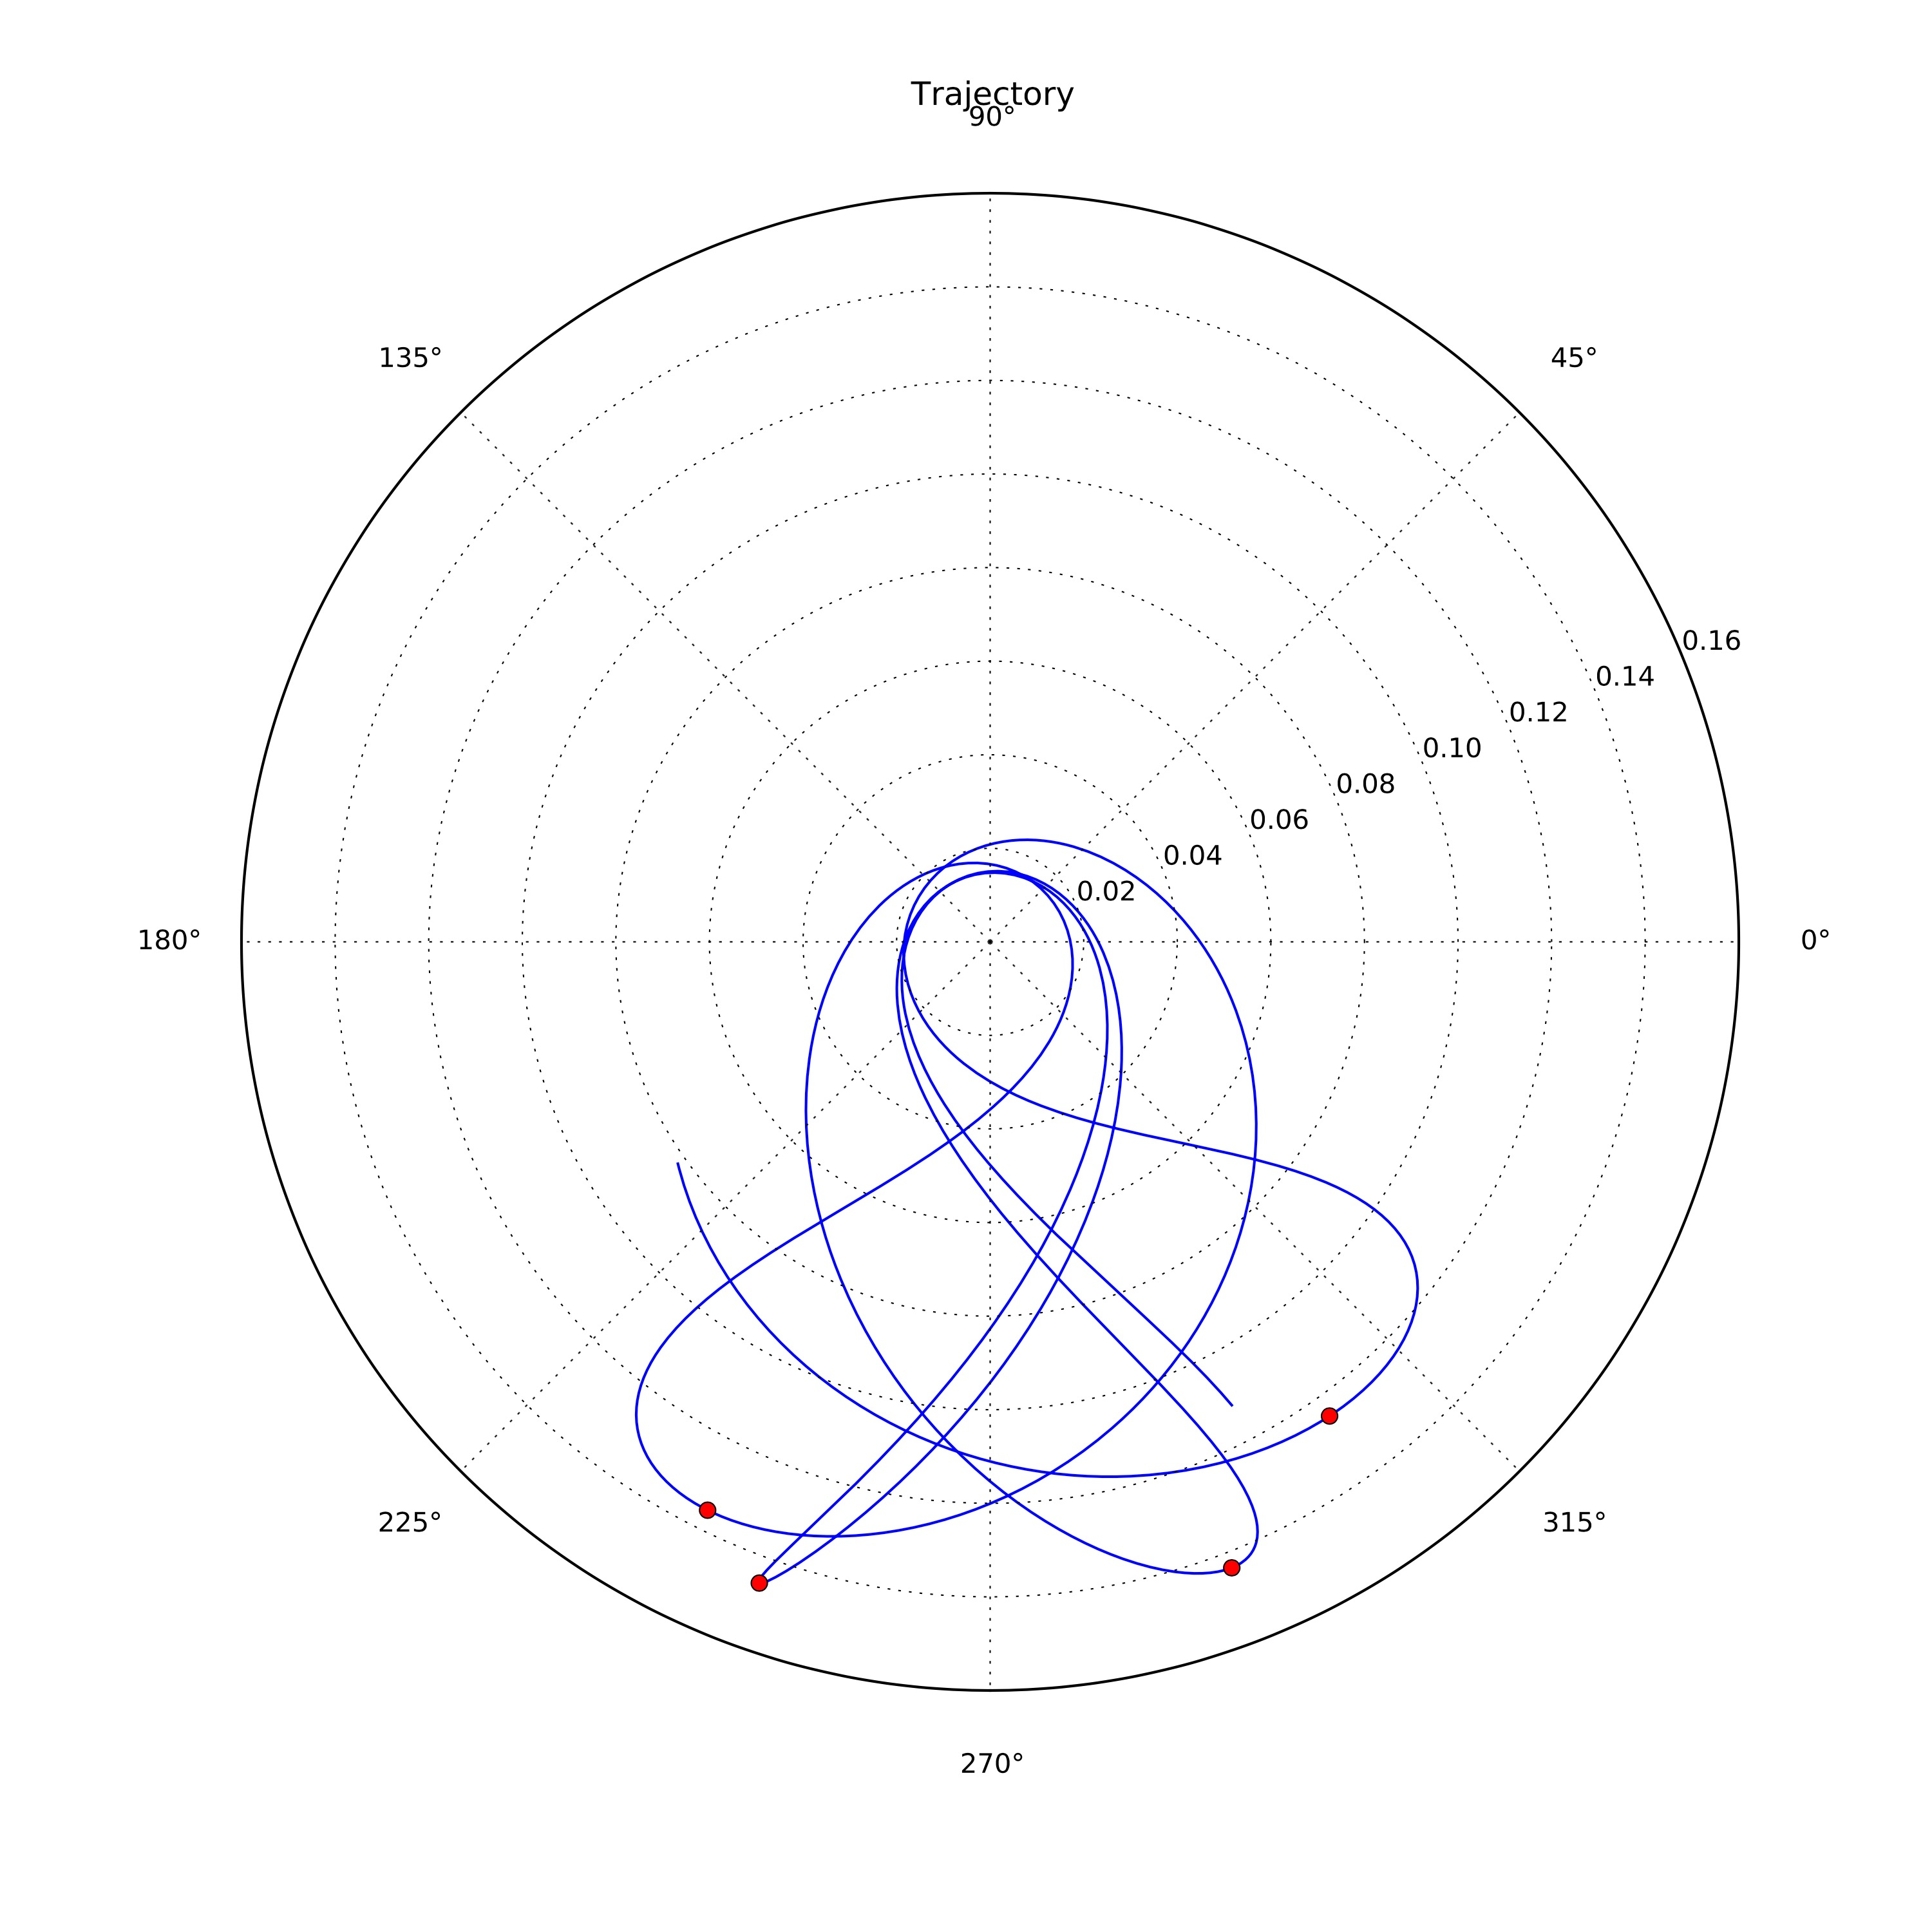
Bifurcation Diagram

Slide 6
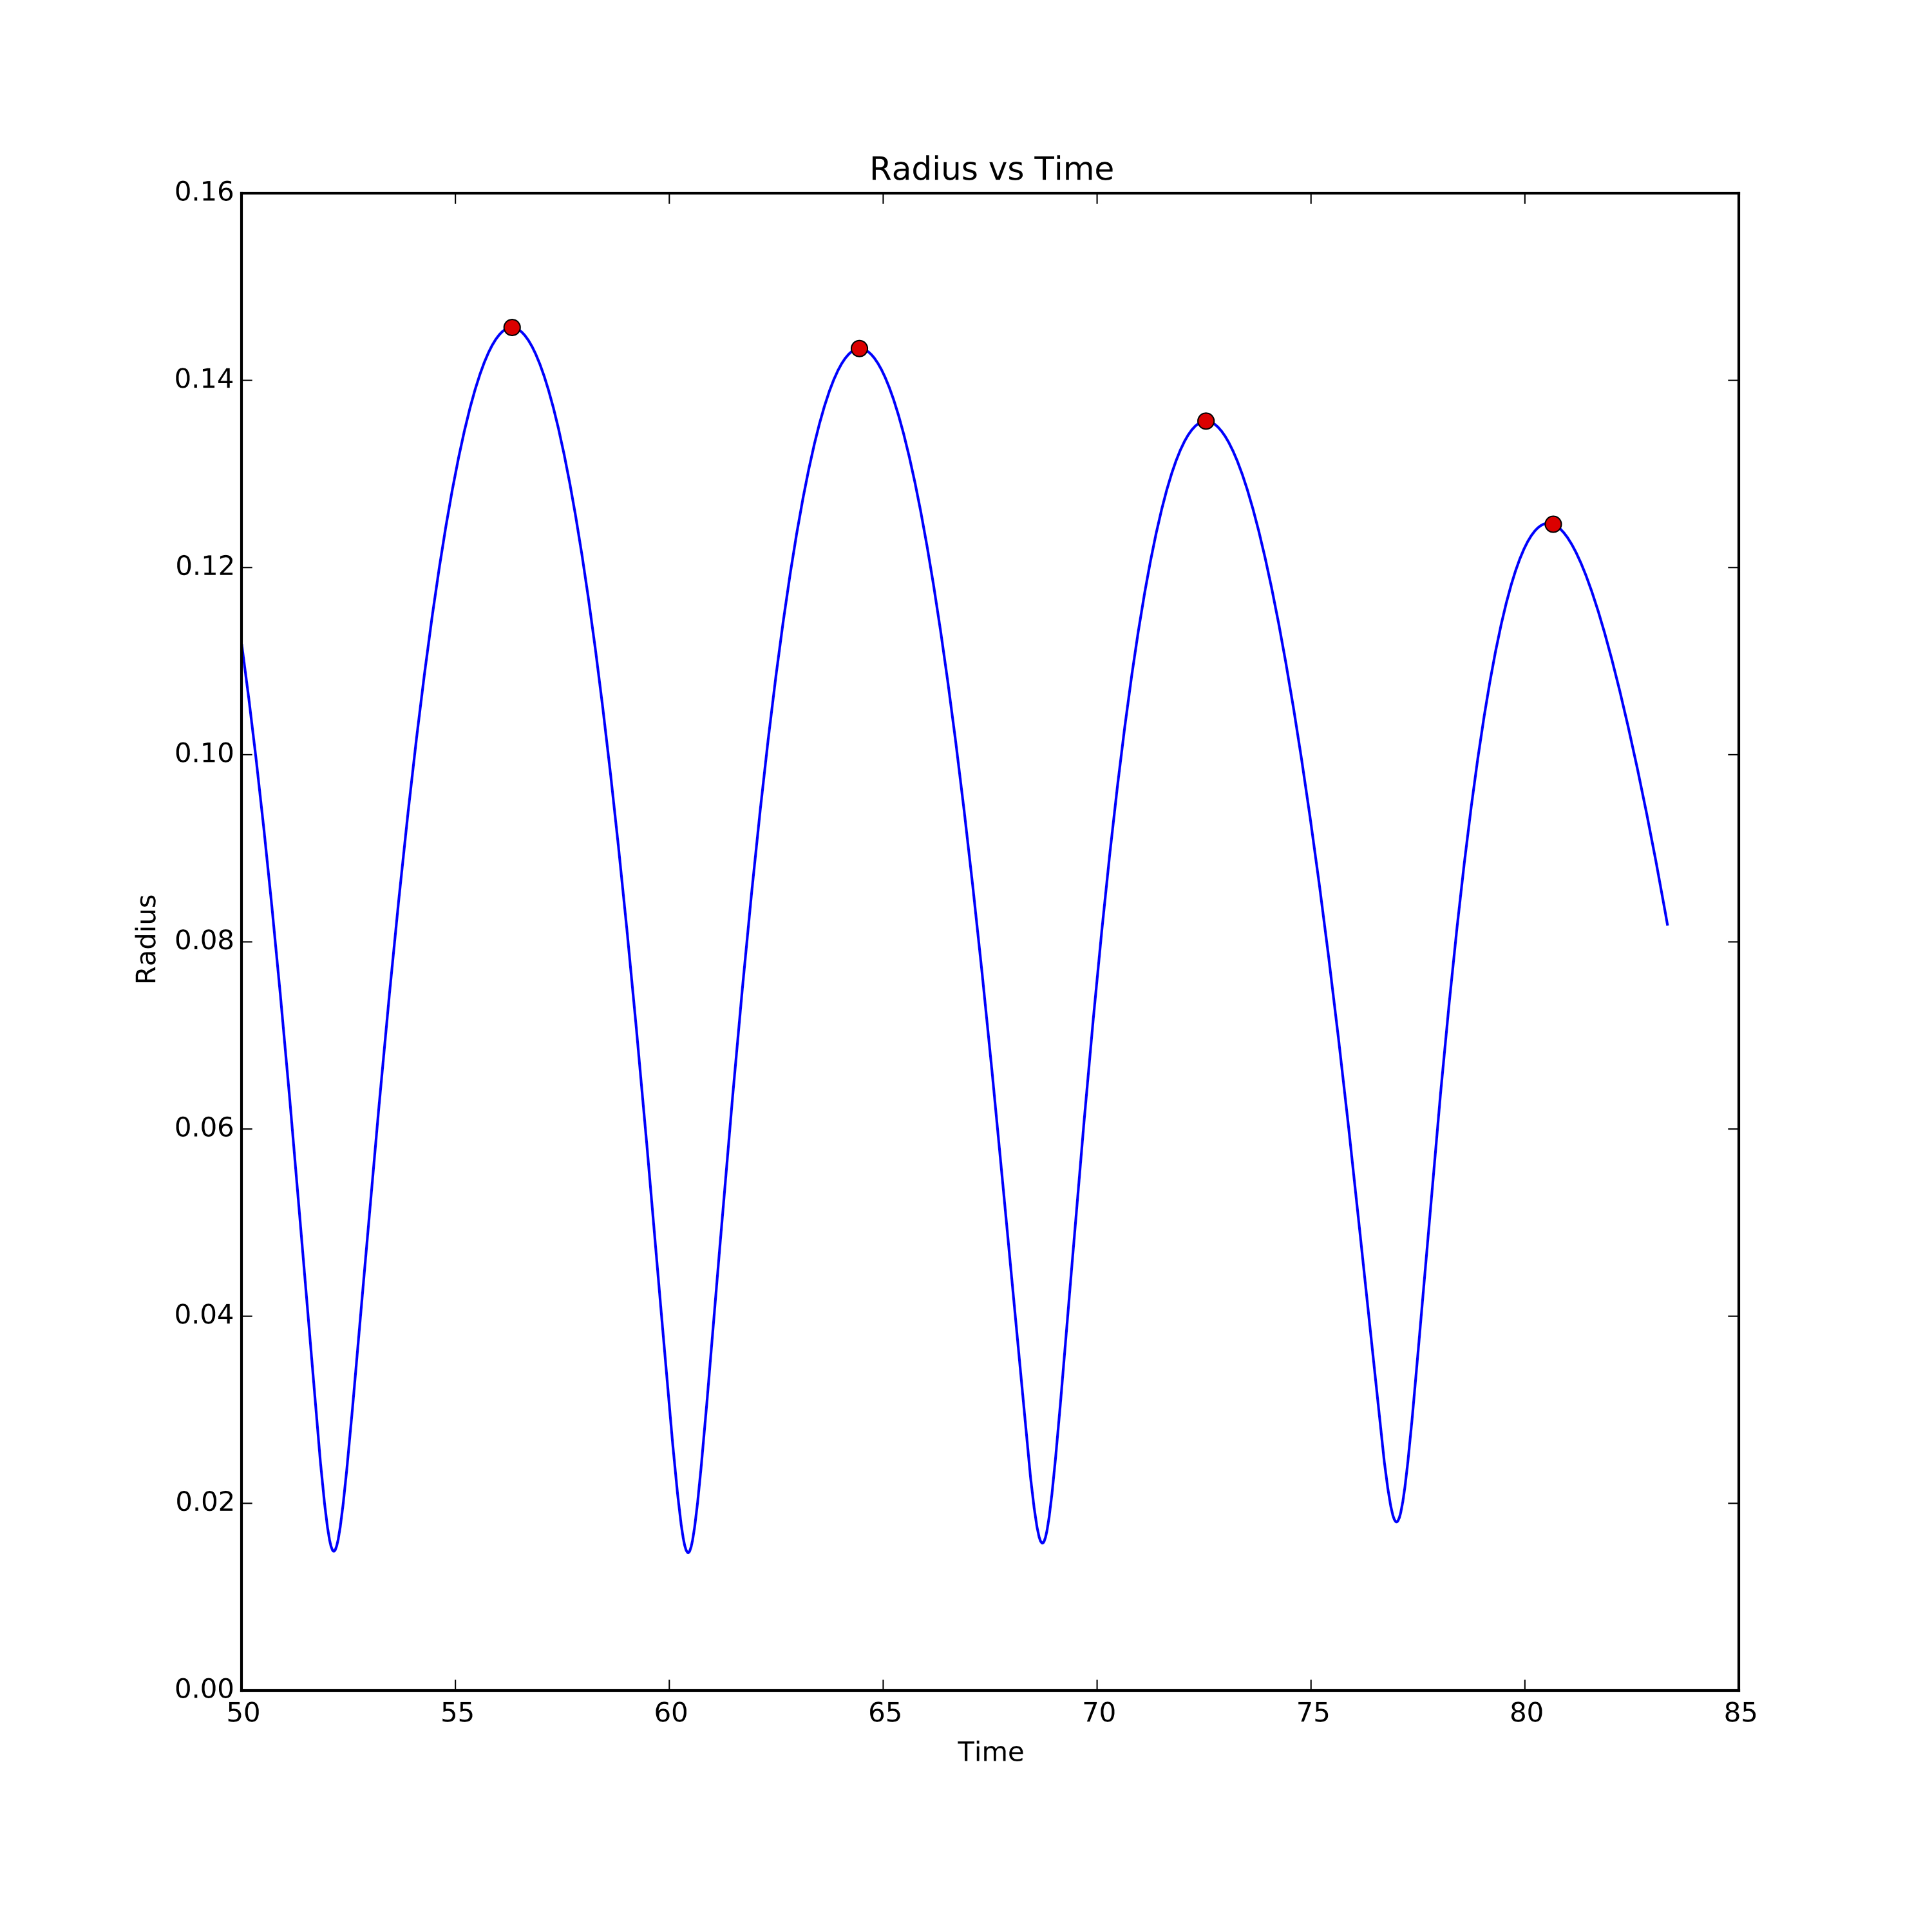
Bifurcation Diagram

Slide 7
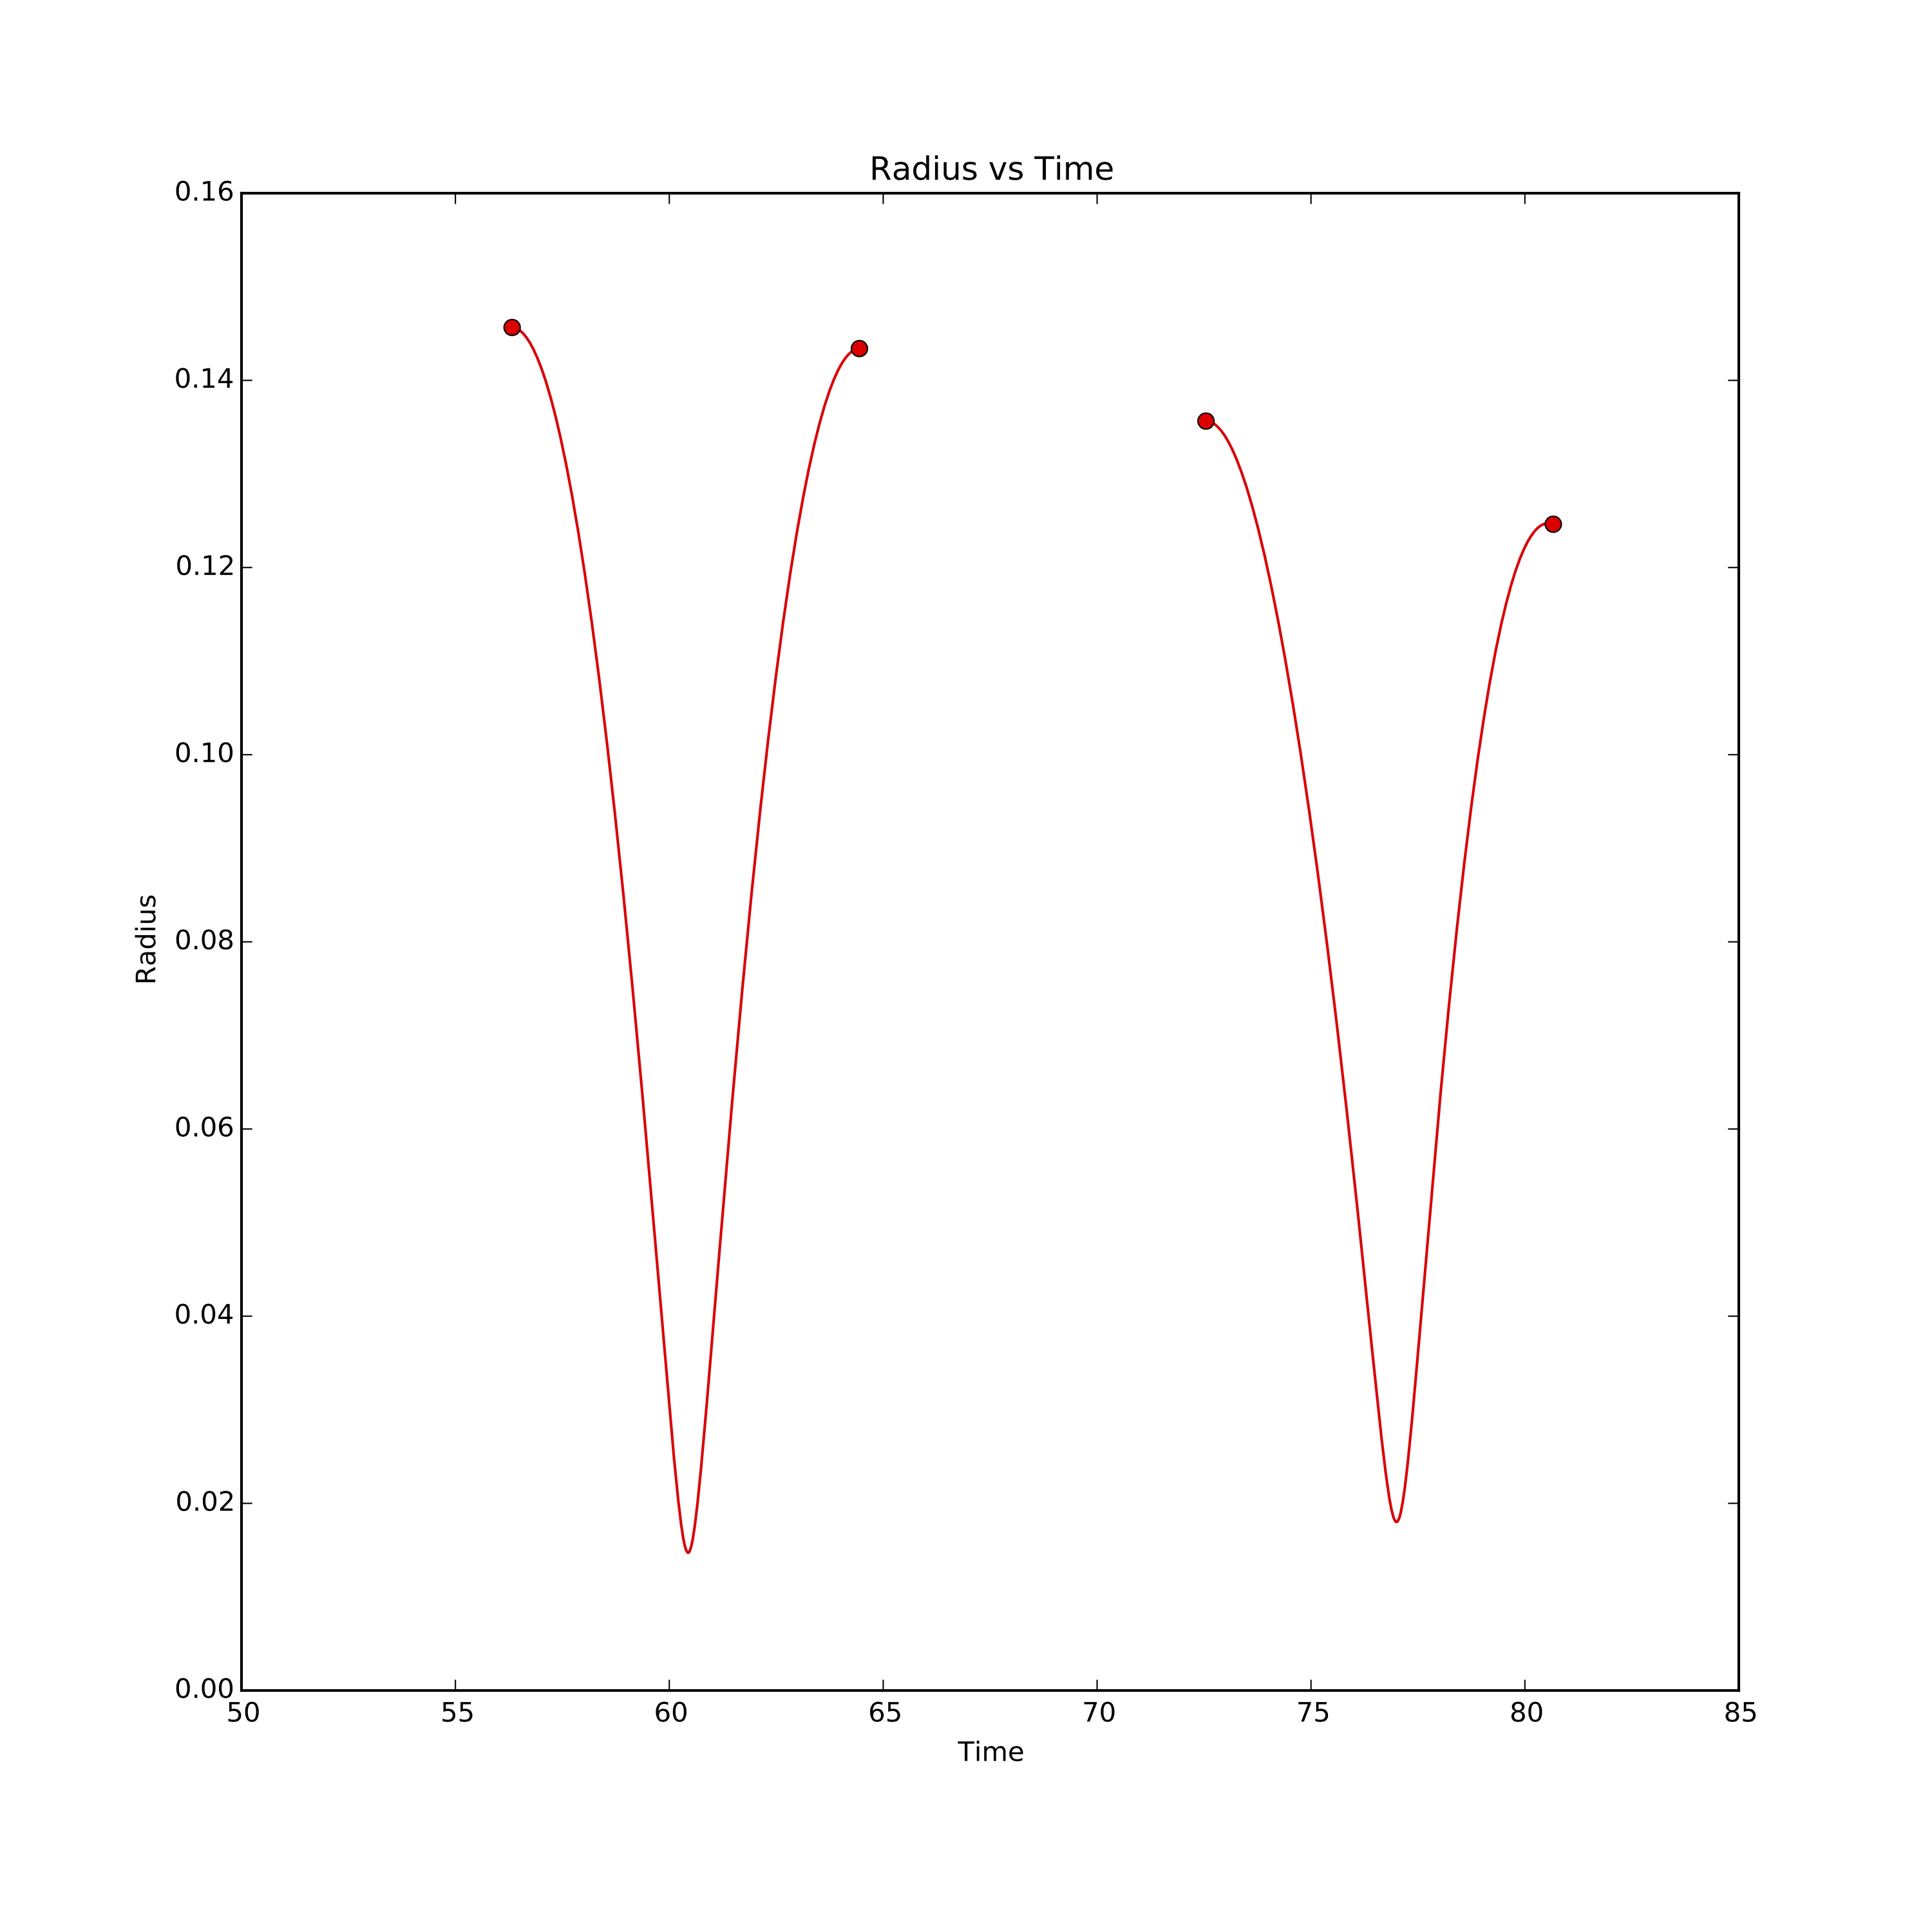
Bifurcation Diagram

Slide 8
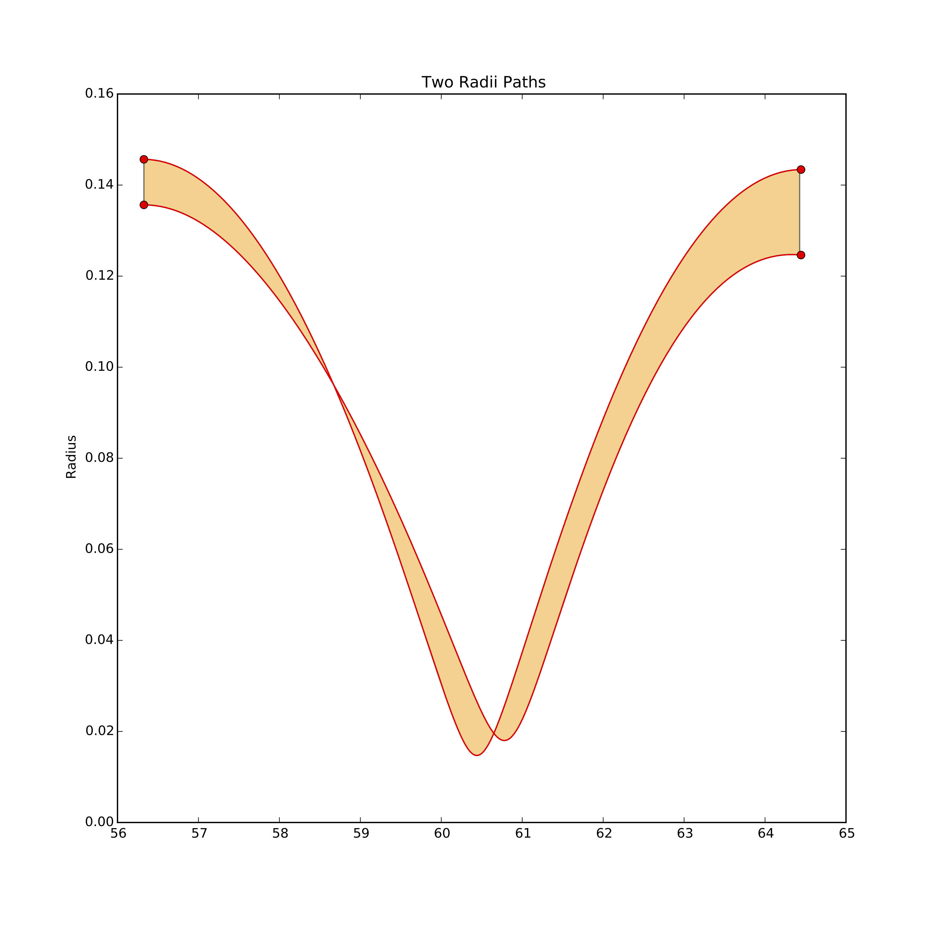
Bifurcation Diagram

Slide 9
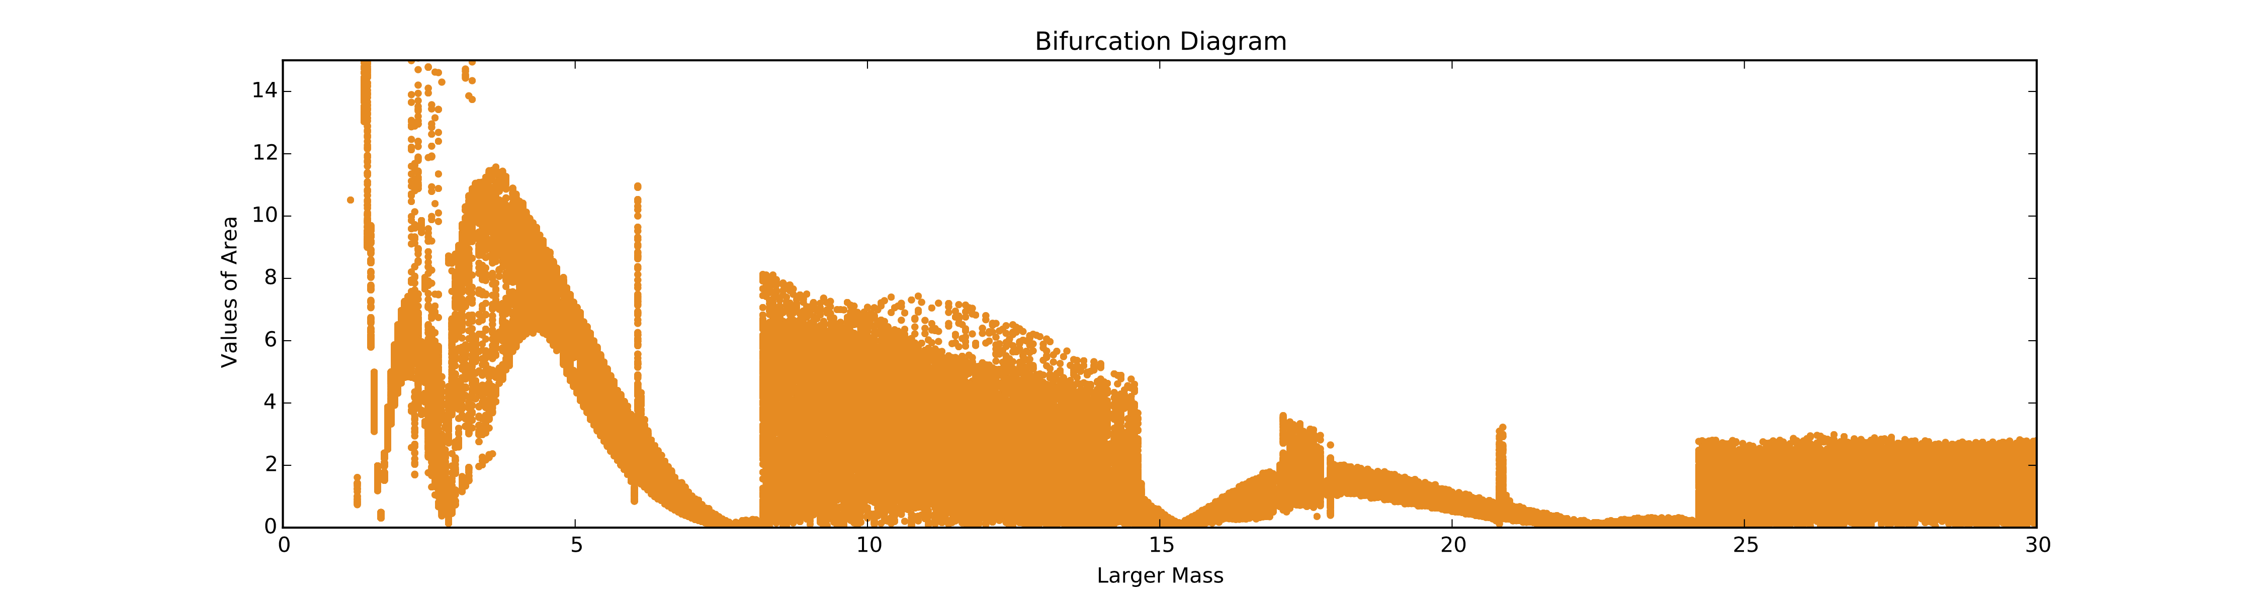
Bifurcation Diagram

Slide 10
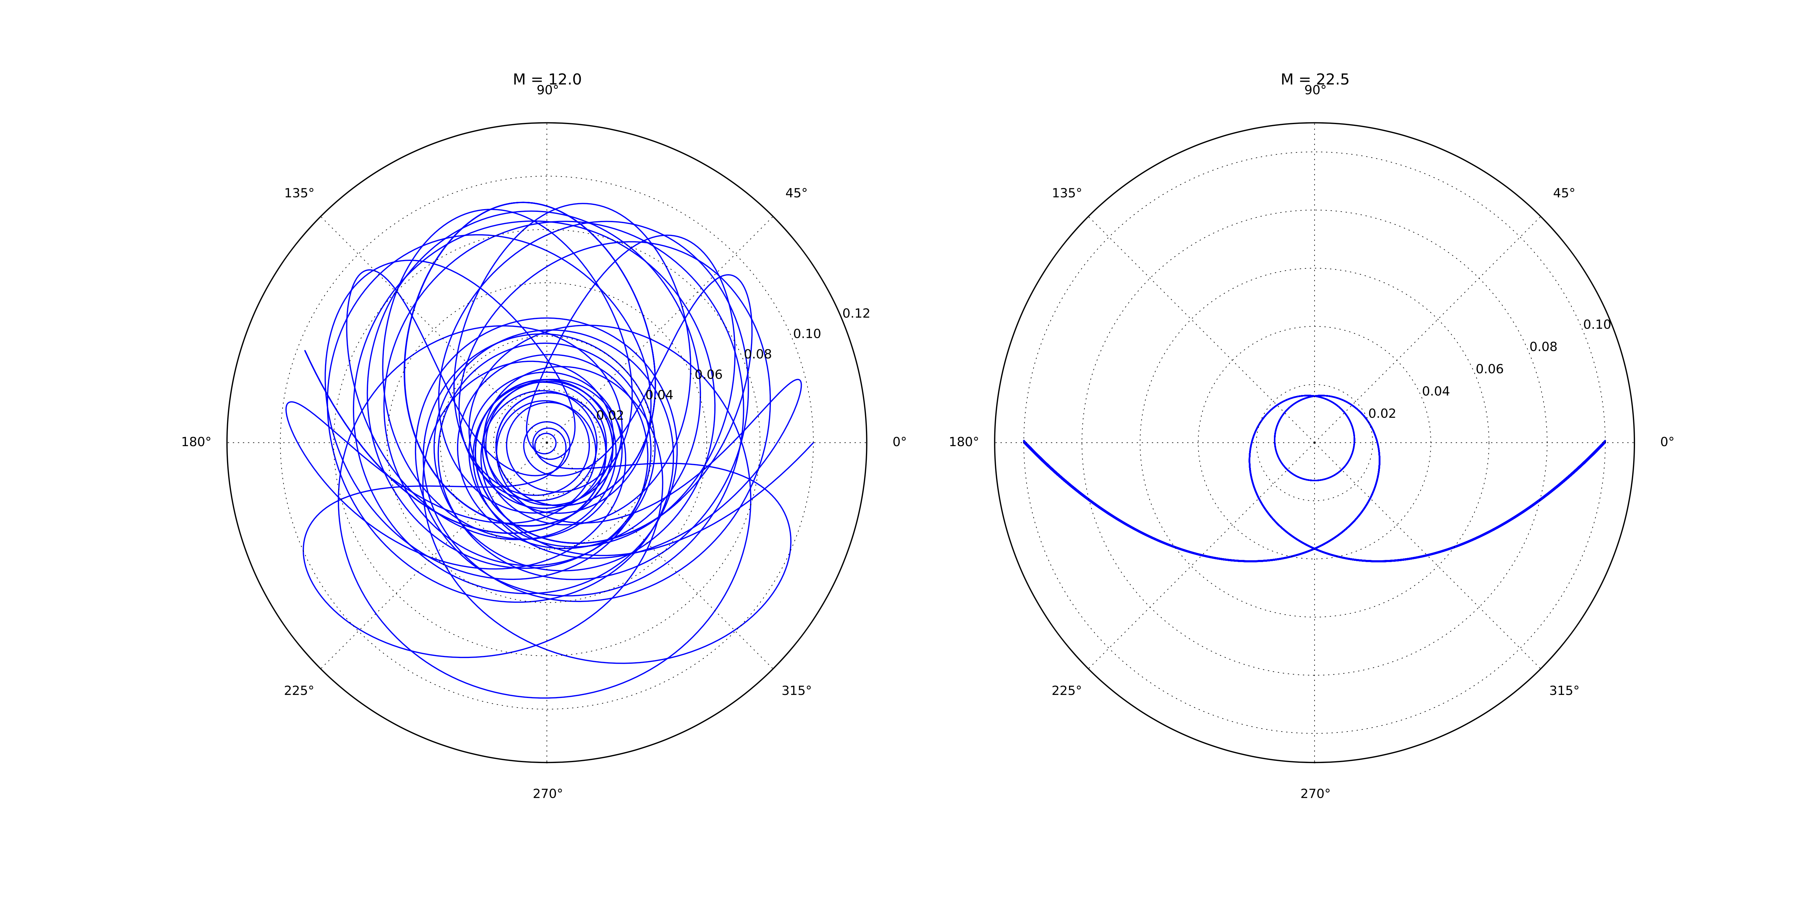
Bifurcation Diagram

Slide 11
Poincaré Maps
Plot radius, radial momentum, and angle
Find times when the angle is 0
Determine the radii and radial momenta for these times
Plot these values for various initial values

Slide 12
